Slide 1
Types of interrupt:
1. External Interrupt:
Used by CPU to interact with I/O device.
This improves system performance by allowing the CPU to execute instructions, instead of just waiting for the I/O device, while still performing the required data transfers.
Internal Interrupt:
Occurs entirely within CPU, I/O devices play no role in these interrupts.
For example, a timer built into the CPU may generate an interrupt at a pre-determined interval.
Software Interrupt:
Generated by the program itself.
It itself is like a subroutine. Eg: HLT
When we give HLT, it calls a predefined subroutine for it, which stops the program we are using.

Slide 2
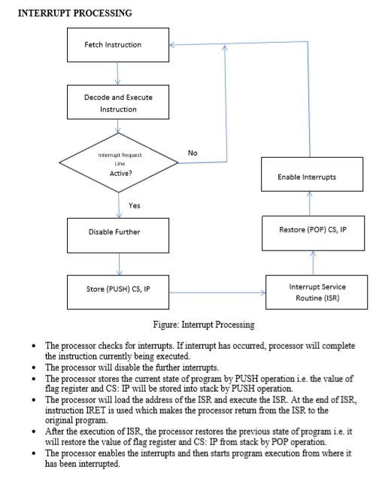
.

Slide 3
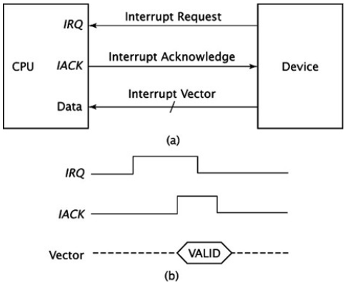
Interrupt hardware and priority Vectored Interrupt
CPU knows the address of ISR in advance.
All it needs is that interrupting device sends its unique vector via a data bus and through its I/O interface to the CPU.
CPU takes this vector, checks an interrupt table in memory and then carries correct ISR for the device.

Slide 4
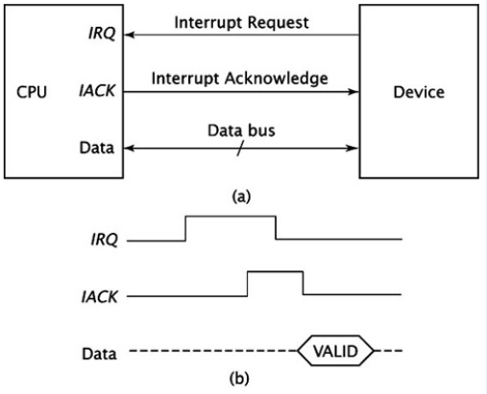
Non-vectored interrupt
Interrupting device never sends an interrupt vector.
CPU receives the interrupt, and it jumps the program counter to a fixed address in hardware.
CPU crucially does not know which device caused the interrupt without polling each I/O interface in a loop and checking status register of each I/O interface.

Slide 5
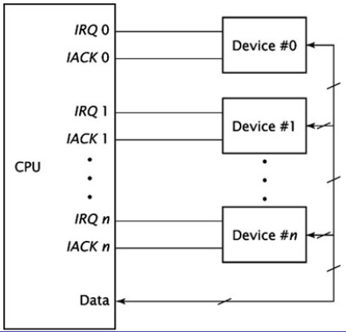
Prioritizing multiple interrupts: Extension of non-vectored Interrupt

Slide 6
Contd…
IRQ_{n} has the highest priority and IRQ₀ has the lowest.
If more than one device requests an interrupt, the CPU acknowledges and serves the interrupt with the highest priority first.
This method works well when there are only a few IRQ/ACK pairs.
As the number of interrupt increases, the number of pins needed by the CPU to accommodate these signals become prohibitive.

Slide 7
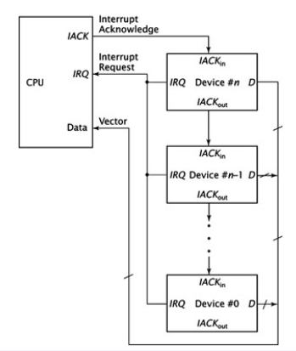
Daisy Chaining

Slide 8
Contd…
The interrupt request signals from the devices are ORed together.
When the CPU receives an active IRQ input, it doesn’t know which device generated the interrupt request.
It sends out an acknowledgement signal and leaves it to the devices to work among themselves.
Device #n receives the IACK signal directly from the CPU.
If IACK is asserted, usually 1, this device has requested an interrupt; it sets its IACK_{out} signal to 0 and places its vector on the data bus.
If this device did not request the interrupt, it sets its IACK_{out} signal to 1, thus passing it to device n-1 and so on until the IACK is asserted
Straightforward and easy to implemented.
The configuration is sequential, and thus can introduce hardware delays, if the chain is too long.

Slide 9
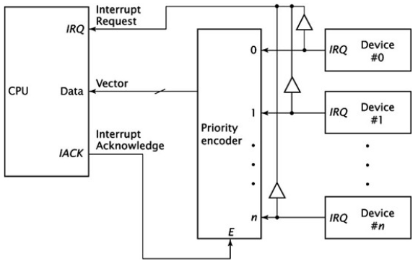
Implementing priority interrupts in parallel
Implemented using priority encoder.
Output of this encoder is the value of the highest priority device requesting an interrupt.
Priority of the device doesn’t determine the time needed to acknowledge the interrupt.

Slide 10
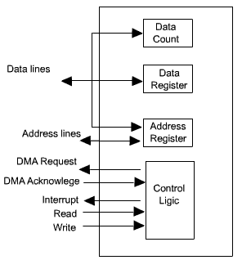
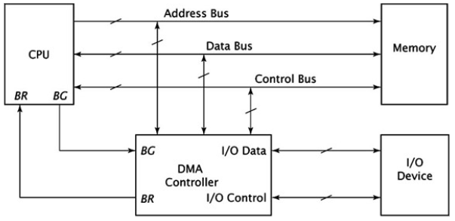
Direct Memory Access(DMA)
Involves an additional module on the system bus capable of mimicking the processor and taking control of system from processor to transfer data to and fro from memory over the bus.
DMA module must use bus only when processor does not need it, or must force the processor to suspend operation temporarily.

Slide 11
Incorporating DMA into a computer system
A DMA controller implements direct memory access in the computer.
Connects directly to I/O devices to one end and to the system bus at other end.
Also interacts with CPU.
To transfer data from an I/O device to memory, DMA controller first sends a bus request to the CPU by setting BR to 1.
When CPU is ready to grant the request, CPU sets its bus grant signal, BG to 1.
DMA controller, now, has control of the system bus.
To load data from I/O device into memory, it asserts the appropriate I/O control signals and load data from I/O device into its internal DMA register.
DMA controller also asserts appropriate signals on the system’s control bus to cause memory to read the data.
Once this is done, DMA controller no longer needs to use the System buses.
It relinquishes its request by setting BR to 0.
CPU, then sets BG to 0; resumes its normal operation.

Slide 12
DMA Transfer modes:
Burst mode/Block Transfer mode: =>Entire block of data is transferred in one contiguous sequence. =>Once the DMA controller is granted access to the system buses by the CPU, it transfer all bytes of data in the data block before relinquishing control of system bus back to CPU. =>Useful for loading programs or data files into memory but it does render the CPU inactive for relatively long periods of time.
Cycle Stealing Mode: =>CPU is not disabled for longer period of time like that in burst mode. =>DMA controller obtains access to the system bus as in burst mode. However, it transfers one byte of data and then deasserts BR, returning control of the system buses back to CPU. =>The process goes on until the entire block of data is transferred. =>Data block is not transferred as quickly as in burst mode, but the CPU is not idled for as long as in burst mode.

Slide 13
Contd…
Transparent mode: =>DMA controller only transfers data when the CPU is performing operations that do not make use of system bus. =>Primary advantage is that CPU never stops executing its programs. =>The hardware needed to determine when the CPU is not using the system buses can be quite complex and relatively expensive. =>This mode is generally not used.

Slide 14
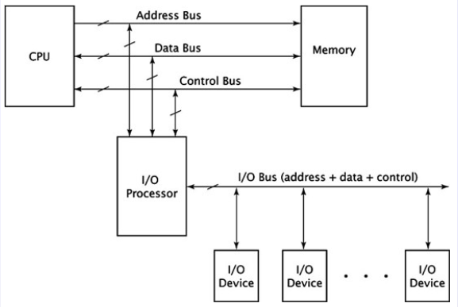
I/O processors:
Figure: system configuration incorporating an I/O processor

Slide 15
Contd…
Are also called I/O controllers, channel controllers or peripheral processing units(PPUs).
I/O processors usually incorporate several DMA controllers within their circuitry.
DMA controller can improve system performance by speeding up data transfers between memory and I/O devices.
In some cases, data must be manipulated once it is read from the I/O device; the DMA controller can only transfer data.
Unlike DMA controller, the I/O processor connects to more than one I/O device.
The I/O devices are grouped together on an I/O bus.
I/O processor can coordinate transfers from several different I/O devices. The only exception is that the CPU coordinates the transfer of data between itself and I/O processor.
Instead of loading values into registers, as with DMA, the CPU issues a series of I/O instructions to the I/O processor. These instructions are often called commands.

Slide 16
Contd…
The first are the block transfer commands. These move block of data and include the necessary parameters. =>These instructions can be used to swap pages in and out of physical memory, and to load programs from disk to memory.
The second type of command performs arithmetic, logic and branch operations. => used by the CPU for data manipulation.
The third type of command is control commands. =>These are usually hardware dependent and critical to the proper functioning of the computer system.

Slide 17
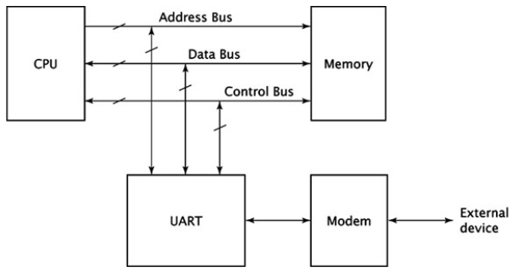
Universal Asynchronous Receiver/ Transmitter(UART):
For asynchronous serial communication, these specialized chips are called universal asynchronous receiver/transmitter or UARTs.

Slide 18
Contd…
CPU sees the UART as just another parallel I/O device and interfaces with it accordingly.
UART transmits and receives data serially.
Can interact with any device that can access serial data.
UART exchanges data with a modem.
To transmit data, UART outputs sequential data to the modem, which modulates the data, combining with a carrier frequency and transmitting it.
To receive data, the modem accepts a signal at a different carrier frequency and demodulates it, extracts the data, and transmit it serially to the UART.
A typical UART contains registers to hold transmitted and received data, a control register and status register.
It contains shift registers, which convert data from parallel to serial(for data transmission) and from serial to parallel(for data reception).

